Slide 1
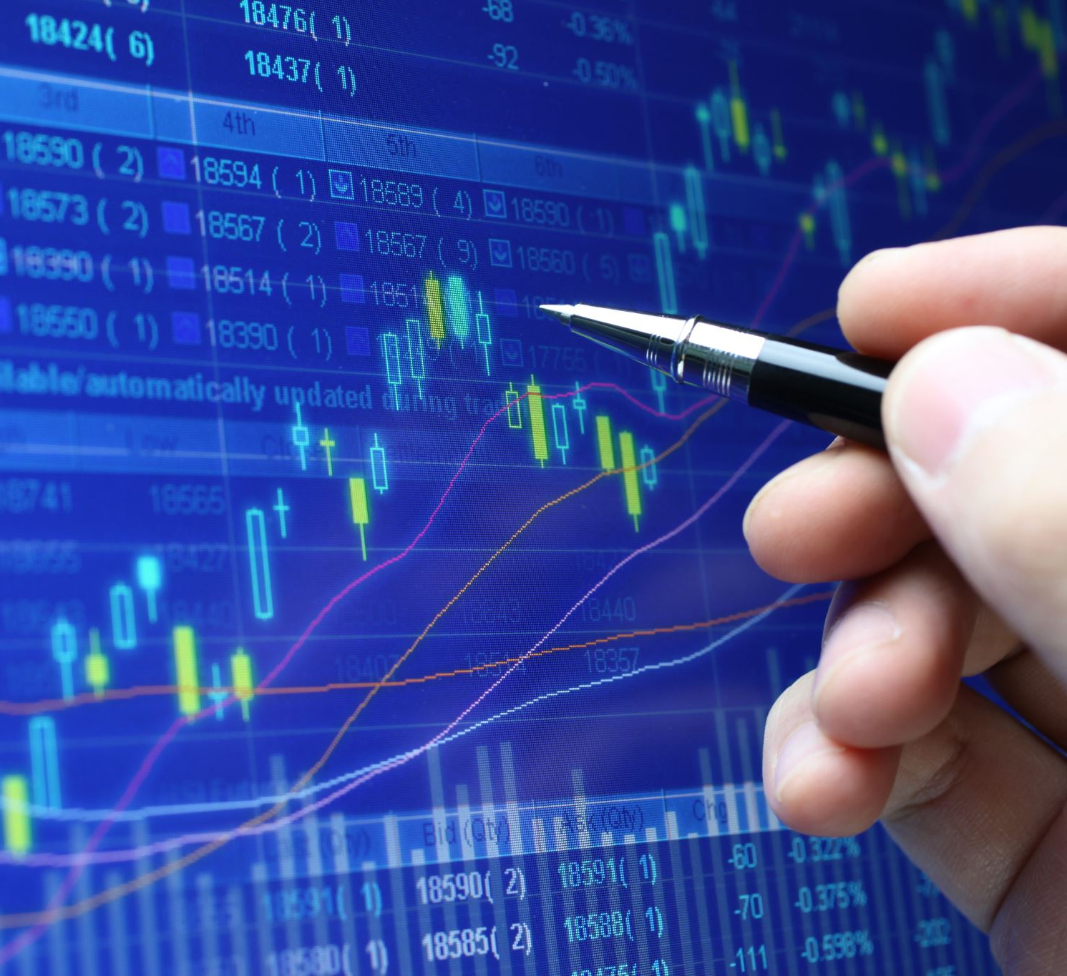
Stocks in Covid Times
Have stocks recovered?

Slide 2
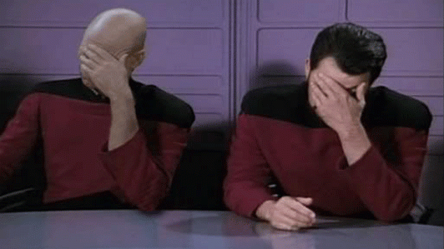
Most important thing we’ve learned
Before doing hours and days of painstaking coding, check to see if there is a library available.
pyEX simplified the process of API calls and gathering the data into a dataframe to a couple lines of code.

Slide 3
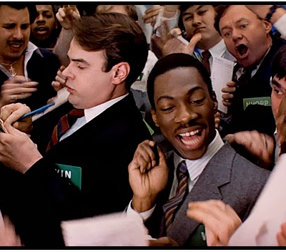
The Data
We will look at the stock prices of randomly selected companies in 5 major industries to see how their stock prices reflect their covid fall and recovery.
Gas – Exxon Mobile – XOM
Entertainment – Disney – DIS
Dining – Darden Restaurants – DRI
Airline – Southwest Airlines - LUV
Hotel – Hilton Worldwide - HLT

Slide 4
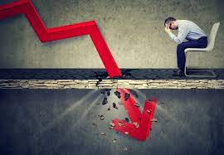
Did our stocks fall as far as the Dow?
On Monday, March 9,2020 the Dow fell 2,014 points, a 7.79% drop.
On March 12, 2020 the Dow fell another 2,352 points, a 9.99% drop and the sixth worst percentage drop in history.
On March 16, 2020 the Dow dropped another 3,000 points losing 12.9%. The drop was so massive the NYSE suspended trading several times during those days.

Slide 5
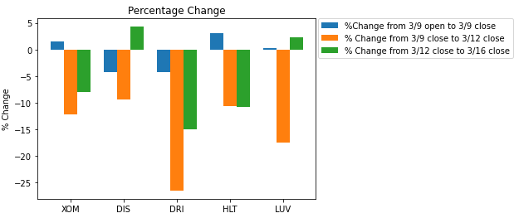
Did our stocks fall as far as the Dow?
Monday, March 9,2020 - 7.79% drop.
None of ours dropped that far
March 12, 2020 - a 9.99% drop
Disney was the only one that didn’t drop that far
On March 16, 2020 - 12.9% drop
Darden and Hilton were the only ones that dropped that far

Slide 6
Hypothesis
If we define recovery here as current closing stock price being equal to or better than the pre-Covid price, our hypothesis is that all 5 industries have recovered.

Slide 7
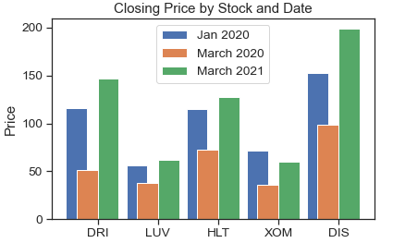
3 Dates
Jan 2020 – Jan 2, 2020 Before covid was seen as a threat
March 2020 – March 16 after a 7k point drop
March 2021 – March 16, 2021, a year after the massive drop

Slide 8
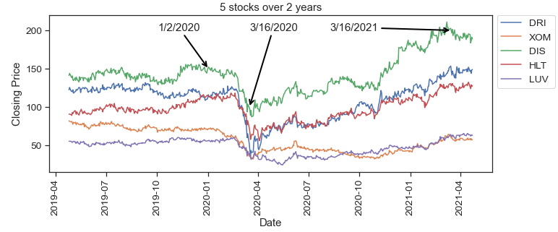
Line graph of the 5 stocks over two years. We have the three dates previously mentioned highlighted. Jan 2, 2020, March 16, 2020, and March 16, 2021.

Slide 9
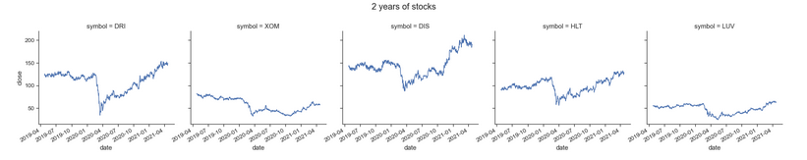
Line graph from previous slide but broken out by symbol

Slide 10
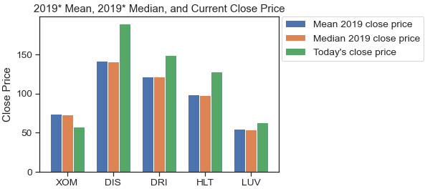
Comparing 2019* mean and median to the current close price. *2019 = April 2019 – December 2019 since data only went back two years

Slide 11
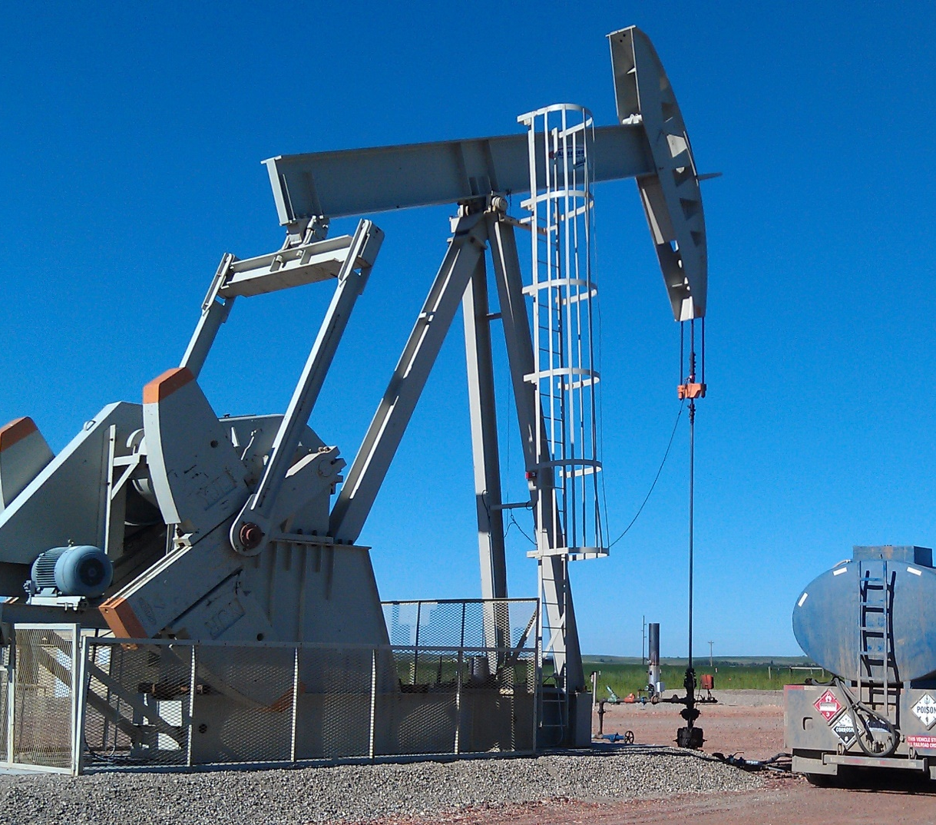
How are we doing?
4 out of the 5 industries we took samples from have current closing stock prices that meet or exceed their pre-Covid prices.
Gas/oil is still lagging behind.

Slide 12
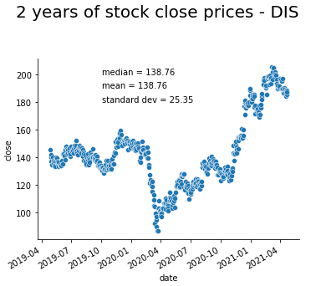
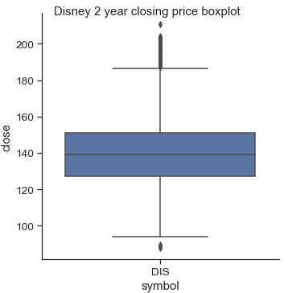
DISNEY
Disney’s 2 years of close prices in a scatter plot with mean, median, and standard deviation.
Disney boxplot

Slide 13

Correlation Over Two Years

